Slide 1
Python IDLE

Slide 2
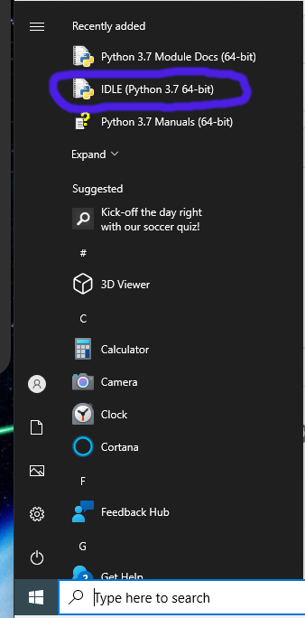
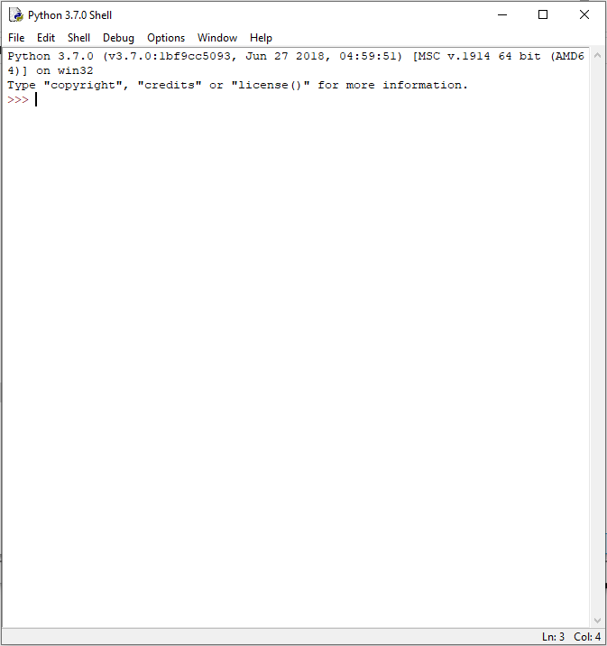
Python Integrated Development and Learning Environment (IDLE)
Use the Windows Key or Click on the Windows Start Button, and type python
Look for IDLE (Python 3.7), click on that to open the IDLE application.
Wait until IDLE has started (It should look something like the image to the right)

Slide 3
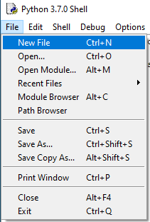
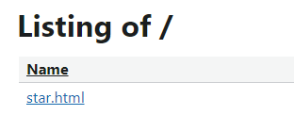
IDLE – A new File
Click the File → New
Open Chrome or Edge (not firefox)
Visit https://gbc.pellcorp.com
Click on the star.html link
Select all the code by using CTRL key and A key
Copy the selected code by using CTRL key and C key
Back to the new Window in IDLE
Paste the code using CTRL key and V key
Save the file using CTRL key and S key
Save it as H:\Documents\star.py

Slide 4
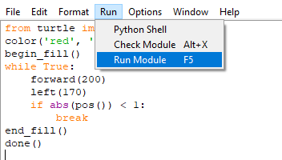
IDLE – Running the code
Once you have saved the file as sample.py
Click the Run → Run Module menu item
It should start up two new windows, and one them should be the familiar turtle drawing a star!
To return to the edit window, you must close the 2 newly opened windows
Do not close the window with the source code
Now we can start playing with this code a bit more, as we started to last week

